Slide 1
Community Analysis: Graphs of Top 100 Words by Frequency from Prominent Twitter Users
Alex Nazareth
Ryerson University

Slide 2

Gephi Procedure
ForceAtlas2 layout algorithm settings (run until it appears to settle)
Scaling = 10 and Gravity = 20
Dissuade Hubs = true
LinLog mode = true
Prevent Overlap = true (only briefly at the end for performance reasons)
Remaining settings left as default
Calculate modularity statistic and partition node colours
Set node size based on degree
Add node labels
Run LabelAdjust, along with some manual visual tweaks

Slide 3

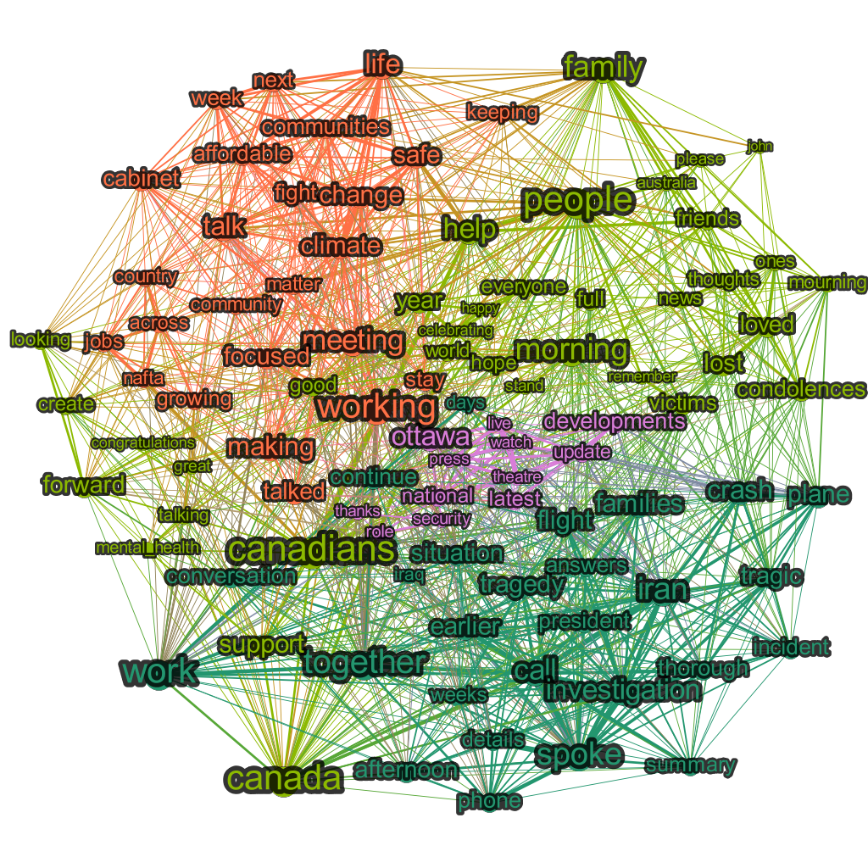
@JustinTrudeau January 2020
Potential Community Meanings
Orange
Policy
Lime green
Positive support
Dark green
Tragedies (Iran plane incident)
Investigation progress
Pink
Updates/news
National security

Slide 4
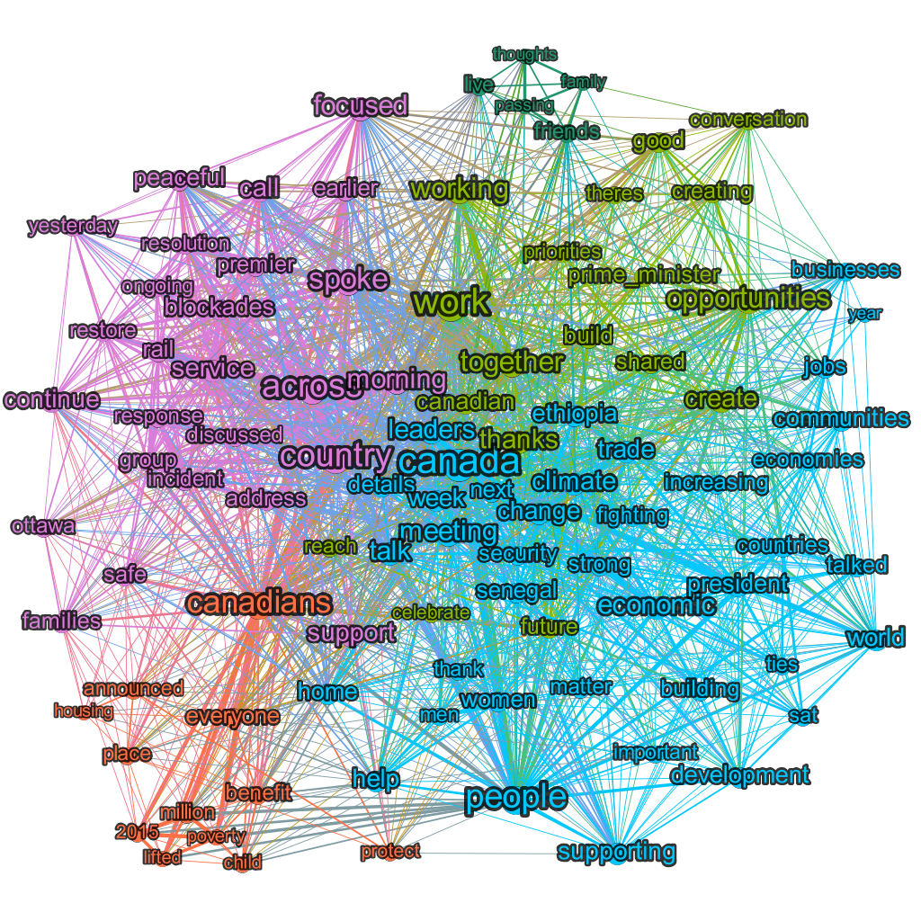
@JustinTrudeau February 2020
Potential Community Meanings
Orange
Canada Child Benefit
Campaign promise to reduce child poverty
Lime green
Policy
Dark green
Condolences for deaths
Blue
Visit to Ethiopia
Pink
Coastal GasLink pipeline protests

Slide 5
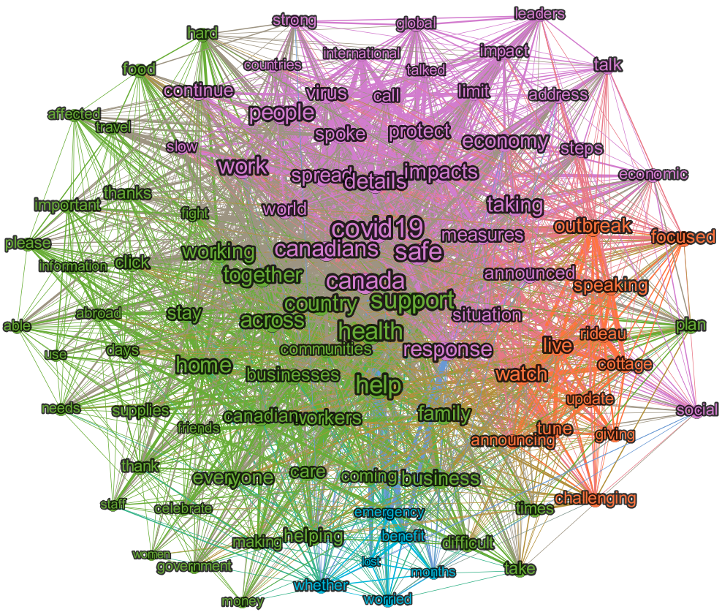
@JustinTrudeau March 2020
Potential Community Meanings
Orange
COVID updates from Rideau Cottage
Lime green
Encouragement
Blue
Lost income relief measures
Pink
COVID measures

Slide 6
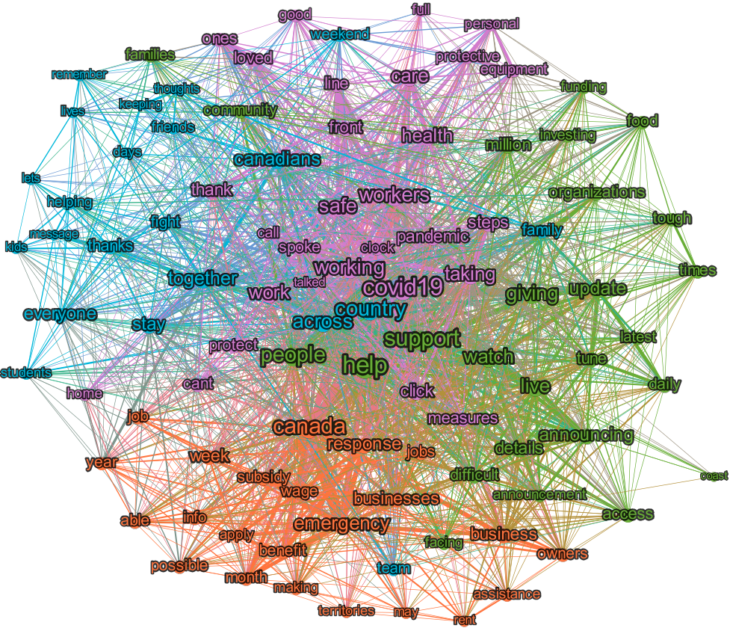
@JustinTrudeau April 2020
Potential Community Meanings
Orange
Economic relief measures (CERB etc)
Lime green
COVID morning updates
Blue
Encouragement
Pink
COVID general healthcare updates

Slide 7
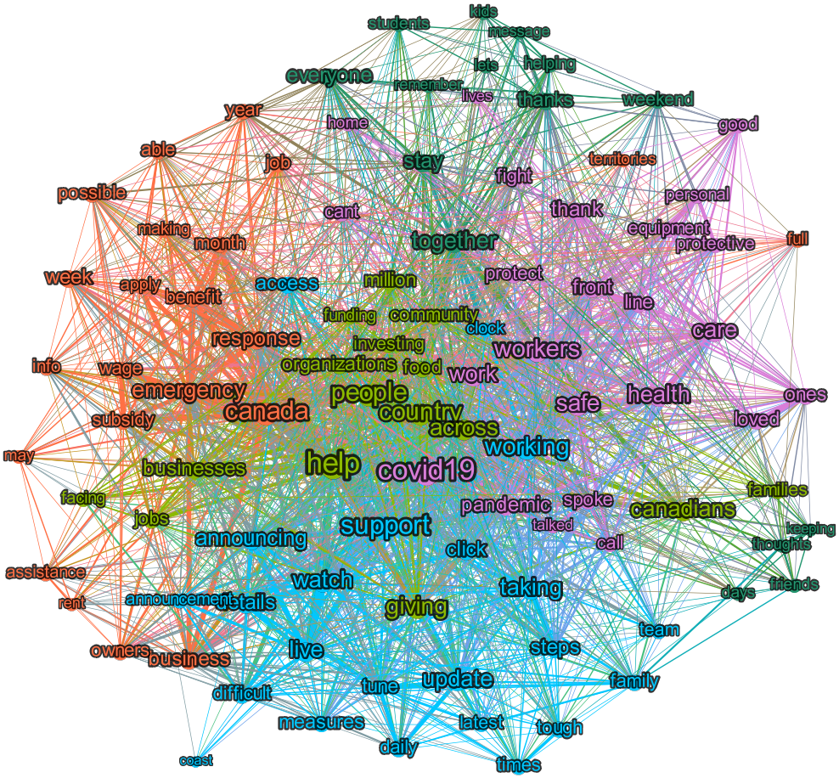
@JustinTrudeau May 2020
Potential Community Meanings
Orange
Economic relief measures (CERB etc)
Lime green
Policy
Blue
COVID morning updates
Pink
COVID general healthcare updates

Slide 8
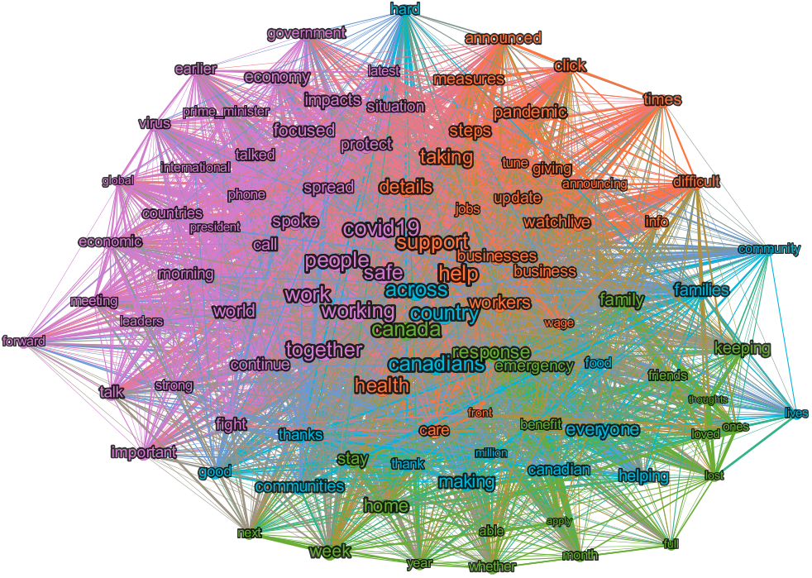
@JustinTrudeau Jan - May 2020
Potential Community Meanings
Orange
COVID daily updates
Lime green
Help
Blue
Encouragement
Pink
Work he is doing

